Slide 1
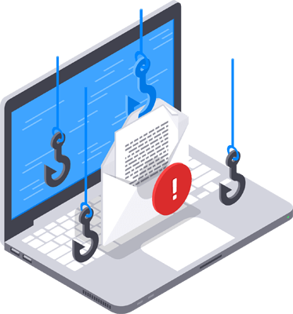
Phishing websites detection using machine learning
Presented by:
Abendi Geetha
MCA- 57
Notes:
NOTE:
To change the image on this slide, select the picture and delete it. Then click the Pictures icon in the placeholder to insert your own image.

Slide 2
Introduction
Phishing : phishing attacks are among the most common and dangerous forms of cybercrime.
These attacks typically involve fraudulent websites that mimic legitimate ones to steal sensitive user information such as passwords, credit card details, or personal data.
Traditional method of detection like blacklists, rule-based filters are reactive, struggle to detect zero-day attacks, and are easily bypassed by new phishing techniques.
Machine learning(ML) offers a proactive and adaptive approach by learning to detect phishing websites base on patterns and features extracted from URL structure, content, and domain metadata.
This presentation explores how supervised machine learning algorithms along with deep learning technique called neural networks can be trained to classify websites as phishing or legitimate based on various extracted features.

Slide 3
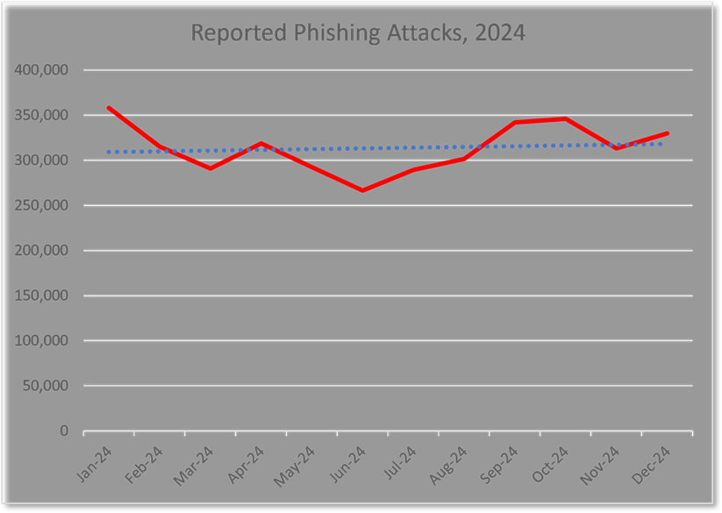
Phishing activity trends report, 4th quarter 2024
These report is provided by the APWG(Anti-Phishing working Group . Major findings : nearly 1 million phishing attacks recorded, webmail and social media most targeted sectors

Slide 4
Literature review
Literature review is taken from IEEE paper of phishing website detection using machine learning.
List-based
2. Visual similarity based

Slide 5
List based detection
List-based detection relies on maintaining databases of known URLs:
Blacklists: Contain URLs or domains identified as phishing or malicious.
Whitelists: Contain verified legitimate URLs or domains.
When a user attempts to visit a website, the system checks the URL against these lists:
If its on the blacklist →access is blocked or flagged.
If its on the whitelist →access is allowed.
If its not on either list→ the system may block it by default(in whitelist-only systems) or allow it but flag it for further analysis

Slide 6
Visual similarity-based detection
Identifies phishing sites by comparing their visual appearance to legitimate websites.
1.Screenshot capture: The system takes a screenshot of the website a user is visiting.
2.Feature extraction: It extracts visual elements of the page are analyzed, such as: icons or favicons, color schemes, layout and structure.
3.Comparison with legitimate sites: The captured visual features are compared with those of known legitimate websites(either stored as images or feature vectors in a database).
5.Similarity scoring: based on the score and possibly additional context(like domain name, HTTPs status), the system determines whether to block or warn about the site.

Slide 7
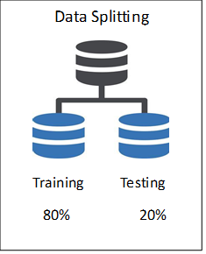
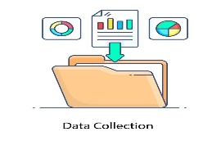
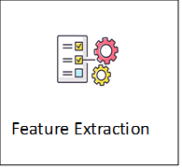
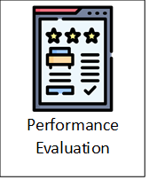





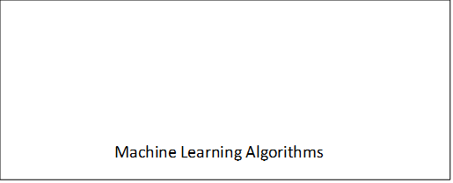
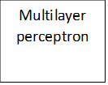
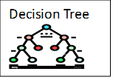
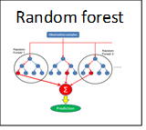
System architecture
There are other methodologies such as traditional techniques like blacklist/whitelist filtering. Because of some drawbacks I tend to use machine learning and deep learning techniques for better accuracy and score. The methodology includes the system Architecture and flow of work used to train a model and performance evaluation with the outcome. Here's a step-by-step methodology I have used in phishing website detection.

Slide 8
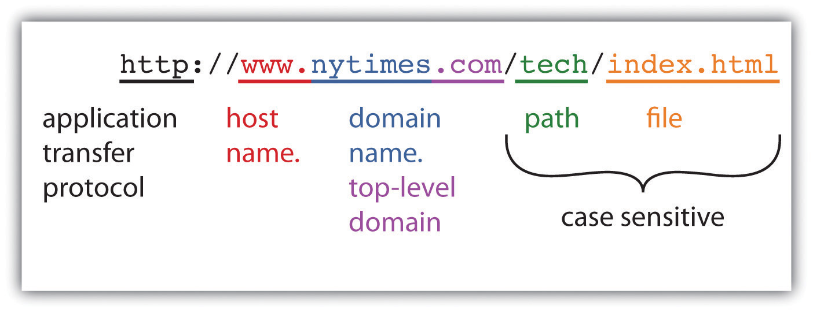
Anatomy of URL

Slide 9
Data collection and feature extraction
Source of data:
Phish Tank –phishing URLs(5000)
, University of Brunswick-
legitimate URLs(5000)
Features are divided into three categories
Feature extraction python file is imported for creation of web application.
URL based | Domain based | Html/JavaScript
URL length | Domain age | On Mouseover
‘@’ presence | Domain expiry
IP address | DNS record | Right click disabled
https token | Prefix-suffix(hyphens) | Web forwarding
url shortening | redirections

Slide 10
Elaboration of each feature with example
1. URL length: excessively long subdomains with extra directories, encoded characters to mimic legitimate sites.
Ex: https://www.google.com.accounts-security-check.com/login.
2.HaveAtSign: domain navigates after the sign. This leads to fraudulent webpage
Ex: https://domain.com@example.com/login
3. https token: in the domain part
Ex: http://https-www.paypal.in.webpps......
4. have IP address: is found instead of domain name
Ex: http://127.127.5.1
5. URL shortening: HTTP redirect on a domain name that is short which links to the webpage that has a long URL.
Ex: https://bit.ly/3gG8XYZ

Slide 11
Domain based features
6.Domain age: often less than 6 months old and frequently just a few days or weeks old. Register new domains and abandon them quickly once discovered.
7.Domain expiry: often registered for short durations typically 1 year or less and sometimes only a few months.
8.DNS record: checks for IP address ,nameserver records, mail exchange ,site verifications, start of authority (admin contact).
All the above were extracted by the WHOIS lookup.
9.Hyphens in domain : ex: https://ncr-exams-gov.in
10.Redirections: spoof legitimate services ,bypass email filters
Ex: http://legit-looking.com → http://phishingsite.com

Slide 12
Html based
11.On mouse over: it is event of JavaScript attribute changes the link destination when the mouse hovers. When you hover, the real destination is different.
12.Right click disabled: preventing copying ,blocking link inspection, prevent source code viewing.
13.Web forwarding: URL redirection or domain forwarding .the phishers abuse web forwarding to hide the real destination and trick users.
masked forwarding – link forwards to another web page content

Slide 13
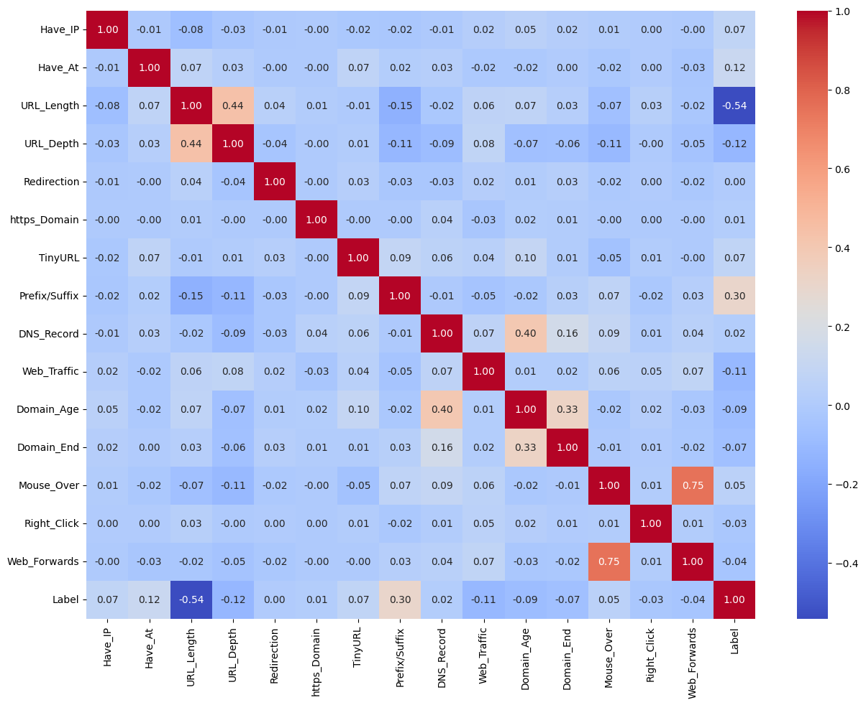
heatmap to understand the correlation between feature variables.

Slide 14
Algorithms used
Machine learning models: deep learning model:
1. decision tree classifier 1. multilayer perceptron's
2. random forest classifier

Slide 15
Comparison table of algorithms classification report
Metric | Decision Tree | Random Forest | MLP
Accuracy | 78.75% | 78.00% | 84.6%
Precision | 97.32% | 98.58% | 93.59%
Recall | 60.29% | 56.27% | 73.92%
F1 Score | 74.74% | 71.89% | 82.92%
Multilayer perceptron outperforms decision tree and random forest in
Recall : finding all phishing websites
F1 score: best balance between precision and recall .Gives us a balanced measure of how good your model is at

Slide 16
Results and analysis
testing phishing website detector with random URLs and analyzing the final output

Slide 17
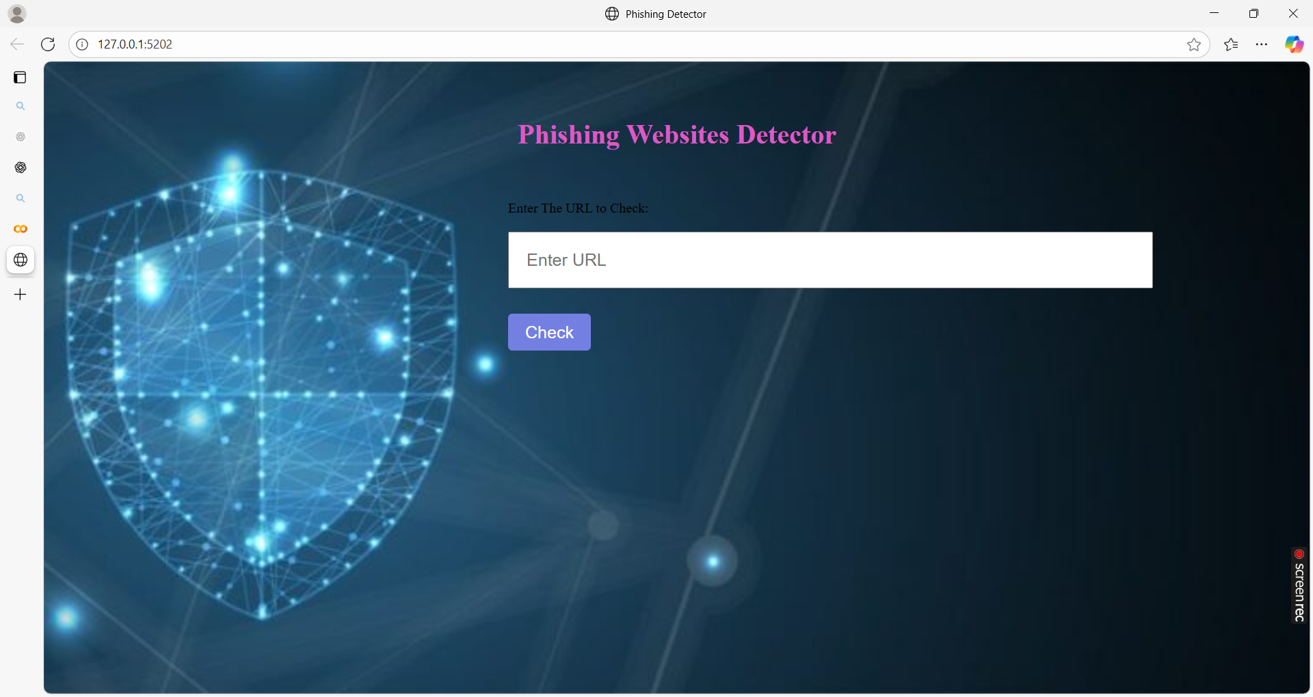
Created an User interface for real time detection

Slide 18
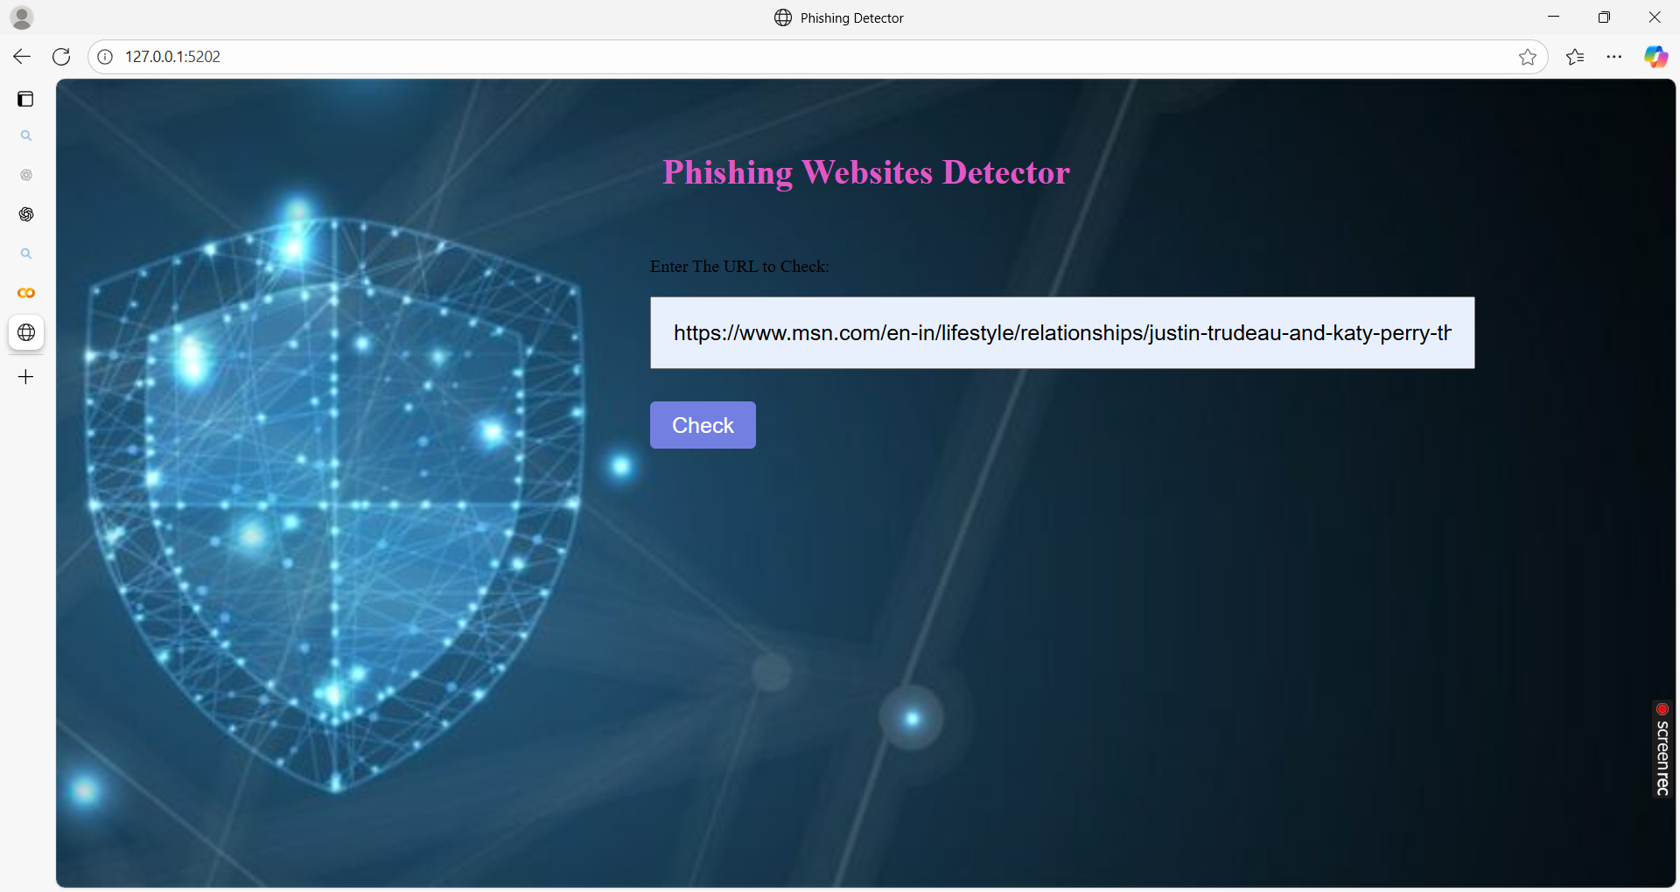
Takes the input as URL and detects

Slide 19
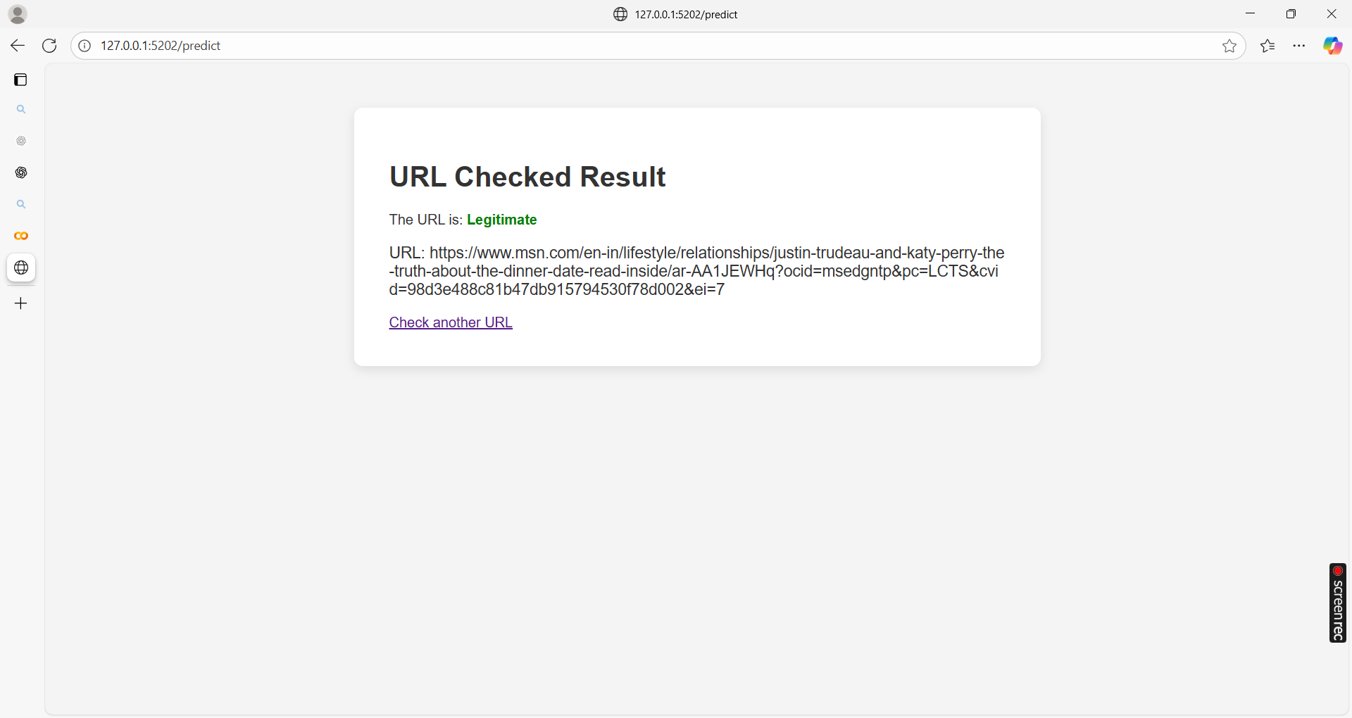
URL checked result is displayed.

Slide 20
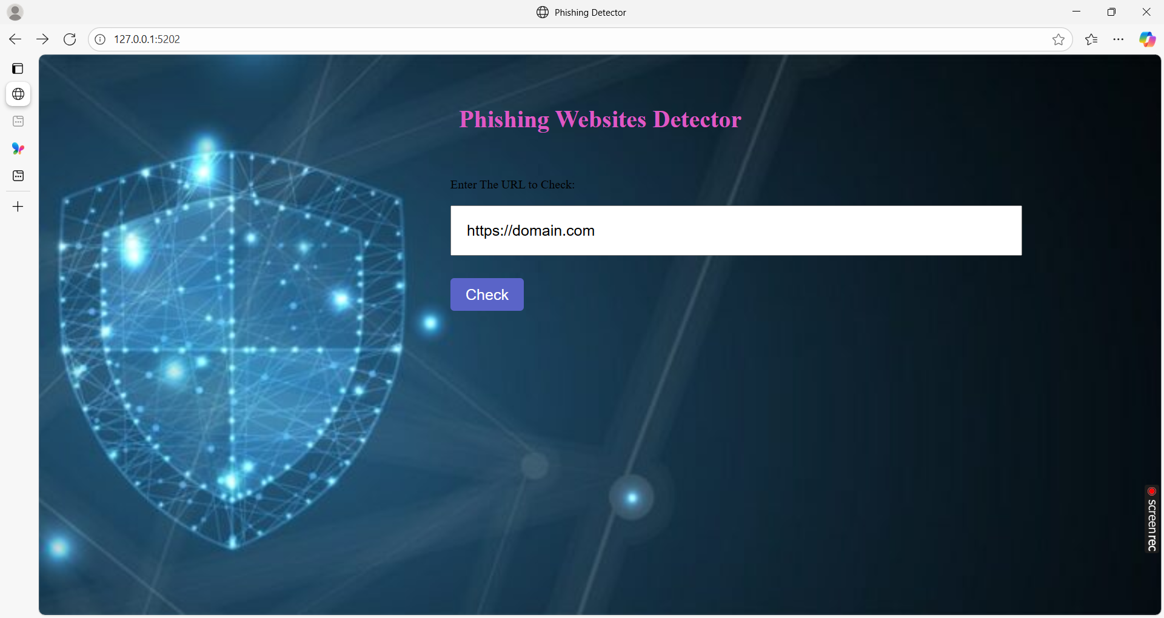
Random domain name given as input to check

Slide 21
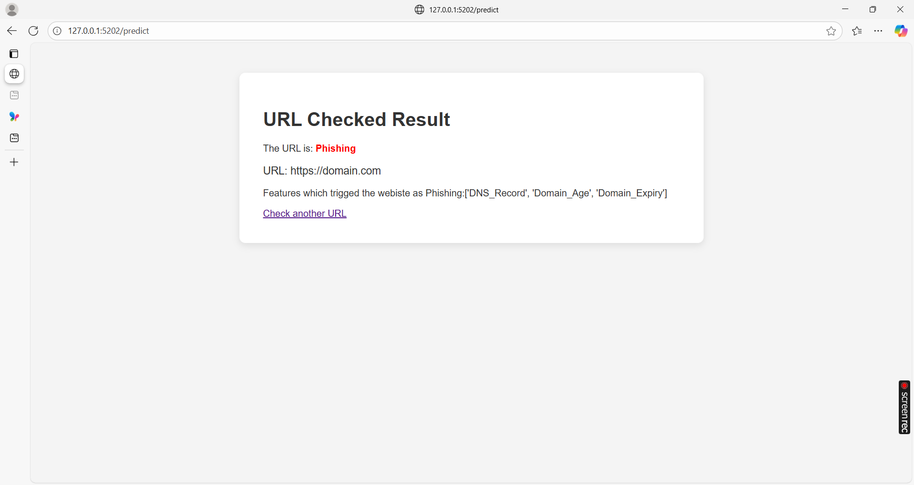

Slide 22
conclusion
Feature extraction is a critical step in detecting phishing websites effectively.
A combination of URL-based, domain-based, HTML/JavaScript-based, and behavioral features enhances detection accuracy. Properly selected features help machine learning models distinguish phishing sites from legitimate ones with high precision.
it is essential to continuously update and refine feature sets.
With robust feature extraction and smart modeling, we can proactively defend against phishing attacks and protect users online.
Don’t click the link if it looks suspicious.

Slide 23
Future work and scope
Integration with Deep Learning
Leverage CNNs or transformer-based models to analyze page screenshots or code content.
Combine image-based and text-based features for multi-modal detection
Collaboration with ISPs and Security Platforms
Work with service providers to blacklist phishing domains early.
Integrate detection systems with SIEMs (Security Information and Event Management) for enterprise security

Slide 24

THANK YOU
“Treat your password like your toothbrush change often but never share it.“
— GEETHA

